Slide 1
Using Data Science to Advance Cancer Research
By Kaitlyn Torres and Charles Howard

Slide 2
Table of contents
01
02
03
04
Introduction
Methodology
You can describe the topic of the section here
You can describe the topic of the section here
Results analysis
Conclusions
You can describe the topic of the section here
You can describe the topic of the section here

Slide 3
1
Introduction
The Story Behind Our Research

Slide 4
What is Data Science
Goal:
Find evidence that supports or challenges a hypothesis.
How?
analyse data to find patterns, anomalies, and/or correlations between different types of information
ex: predictive modeling, statistical analysis, clustering, etc…

Slide 5
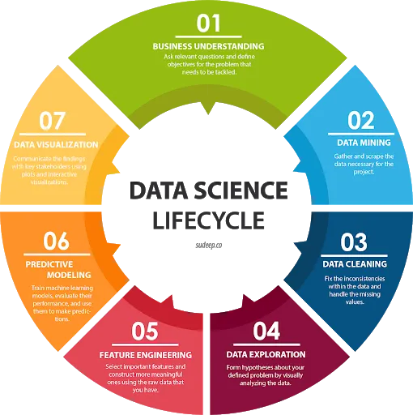

Slide 6
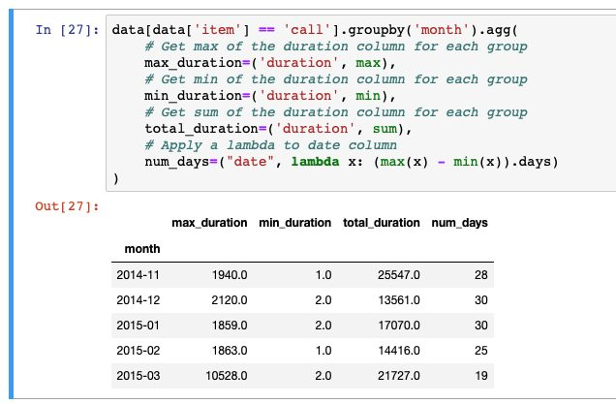
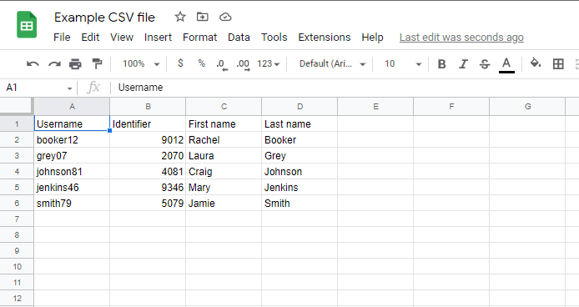
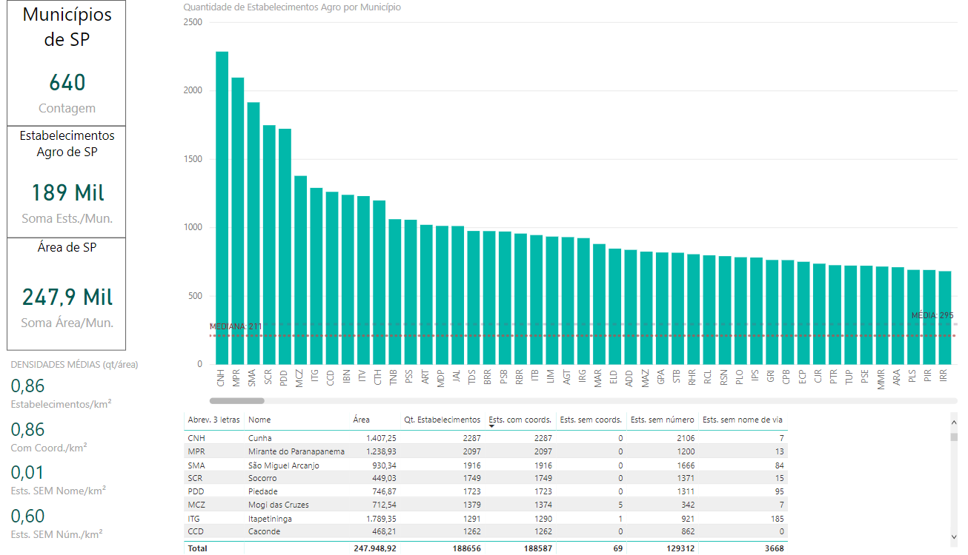
Technologies
There are many different tools that can be used when using data science:
1. Data Storage: Excel, CSV, JSON, txt files, etc
2. Data extraction/ analysis: Python, R
3. Data Visualization: Tableau, Power BI, Python (plotly, ggplot, etc )

Slide 7
The Rise of Data Science
Once only prevalent in technical fields, data science has emerged in a variety fields that include but are not limited to:
education
finance
marketing
HEALTHCARE

Slide 8
Data Science in Healthcare
Benefits:
Better diagnostics,
Early detection of issues
Used to help and diagnose patients virtually
Usage:
Discover new drugs using Artificial Intelligence
Analysis of Medical Imaging (MRIS, CAT)
Disease Tracking and Prevention
Diagnose Cancer at early stages

Slide 10
2
Methodology
You can enter a subtitle here if you need it

Slide 11
Do you need longer text?
Mercury is the closest planet to the Sun and the smallest one in the entire Solar System. This planet's name has nothing to do with the liquid metal, since Mercury was named after the Roman messenger god. Despite being closer to the Sun than Venus, its temperatures aren't as terribly hot as that planet's. Its surface is quite similar to that of Earth's Moon, which means there are a lot of craters and plains
Speaking of craters, many of them were named after artists or authors who made significant contributions to their respective fields. Mercury takes a little more than 58 days to complete its rotation, so try to imagine how long days must be there! Since the temperatures are so extreme, albeit not as extreme as on Venus, and the solar radiation is so high, Mercury has been deemed to be non-habitable for humans

Slide 12
Results Analysis
3
You can enter a subtitle here if you need it

Slide 13
United States Results

Slide 14
New York Results

Slide 15
Florida Results

Slide 17
Do you know what helps you make your point crystal clear? Lists like this one:
They’re simple
You can organize your ideas clearly
You’ll never forget to buy milk!
And the most important thing: the audience won’t miss the point of your presentation

Slide 18
Do you know what helps you make your point crystal clear? Lists like this one:
They’re simple
You can organize your ideas clearly
You’ll never forget to buy milk!
And the most important thing: the audience won’t miss the point of your presentation

Slide 19
4
Conclusion
You can enter a subtitle here if you need it

Slide 20
Background
Venus
Mars
Saturn
Venus is the second planet from the Sun
Mars is actually a very cold place
Saturn is composed of hydrogen and helium
Mercury
Jupiter
Neptune
Mercury the closest planet to the Sun
Jupiter is the biggest planet of them all
Neptune is very far away from the Sun

Slide 21
—Someone Famous
“This is a quote, words full of wisdom that someone important said and can make the reader get inspired.”

Slide 22
Goals
Challenge
Results
Solution
Mars is a very cold place. It’s full of iron oxide dust, which gives the planet its reddish cast
Jupiter is the biggest planet in the Solar System and the fourth-brightest object in the night sky
Venus has a beautiful name and is the second planet from the Sun. It’s hot, even hotter than Mercury

Slide 23
Methods
01
02
03
04
Mercury
Mercury is the closest planet to the Sun
Mars
Despite being red, Mars is a cold place
Venus
Venus is the second planet from the Sun
Jupiter
Jupiter is the biggest planet of them all

Slide 24
Research and publications
“Neptune is the farthest planet from the Sun and the fourth-largest object in the Solar System!”
“Mars is a cold place. It’s full of iron oxide dust, which gives the planet its reddish cast”
“Mercury is the closest planet to the Sun and also the smallest one in the entire Solar System”
By Neptune
By Mars
By Mercury

Slide 25
Maybe you need to divide the content
Mercury
Venus
Mercury is the closest planet to the Sun and the smallest one in the Solar System—it’s only a bit larger than the Moon
Venus has a beautiful name and is the second planet from the Sun. It’s hot and has a poisonous atmosphere

Slide 26
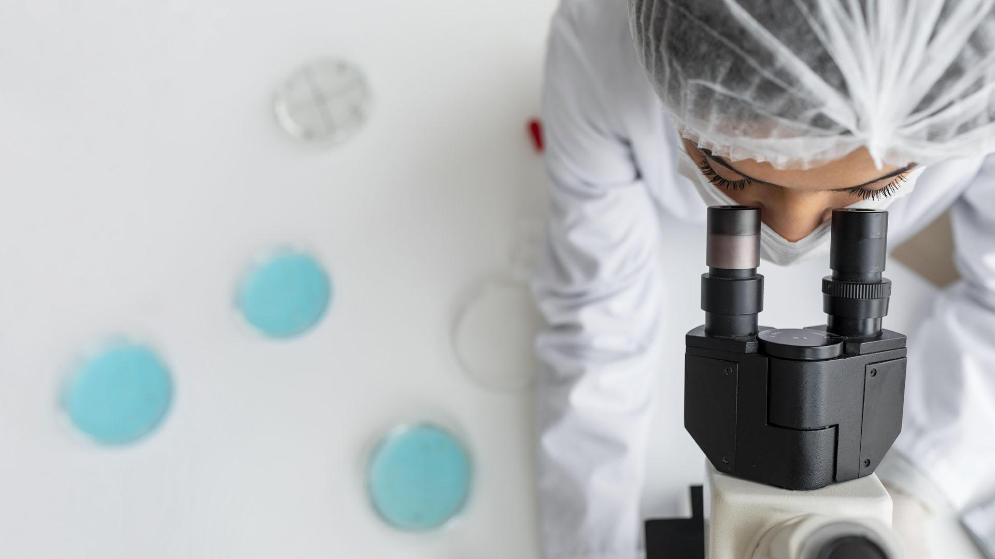
A picture is worth a thousand words

Slide 27
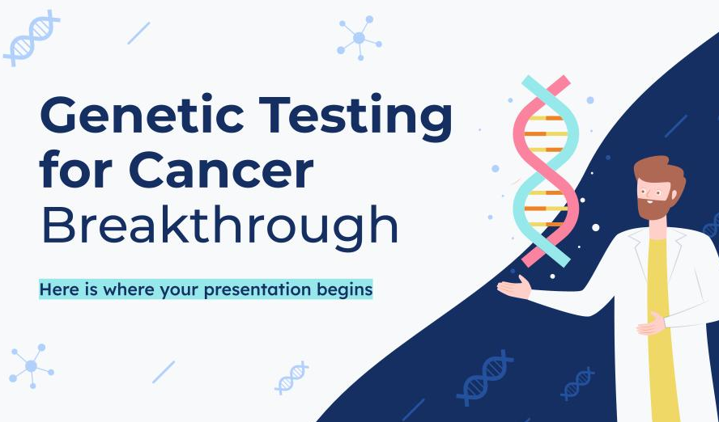
Computer mockup
You can replace the image on the screen with your own work. Just right-click on it and select “Replace image”

Slide 28
This is a map
Venus
Venus is the second planet from the Sun
Mercury
Mercury is the closest planet to the Sun
Mars
Despite being red, Mars is a very cold place

Slide 29
Research resources
You can list your reference websites or publications here
You can list your reference websites or publications here
You can list your reference websites or publications here
You can list your reference websites or publications here
You can list your reference websites or publications here
You can list your reference websites or publications here

Slide 30
Factors to consider
Mercury
Mars
Mercury is the smallest planet of them all
Despite being red, Mars is actually a cold place
Venus
Saturn
Venus is the second planet from the Sun
Saturn is composed of hydrogen and helium

Slide 31
Clinical trial
Preclinical
Phase 1
Phase 2
Phase 3
20%
20%
20%
First studies
Human safety
Expanded safety
Efficacy & safety
Result
Result
Result
Mars is a very cold place
Jupiter is the biggest planet
Earth is the place where we all live
90%
90%
90%

Slide 32
Trial timeline
Venus is very hot
Saturn is a gas giant
Research
Results
1
2
3
4
5
Preclinical
Conclusions
Mercury is very small
Jupiter is big
Experimentation
Mars is a cold place

Slide 33
Phase 1
70%
30%
Sample
Success rate
Young healthy people
225 - 407 patients
3 years follow up
Saturn is a gas giant
Secondary effects
Mars is a cold place
Results
Goal
1 year
What data have we collected in the study?
Check the effectiveness of the treatment
Approximate experimentation time

Slide 34
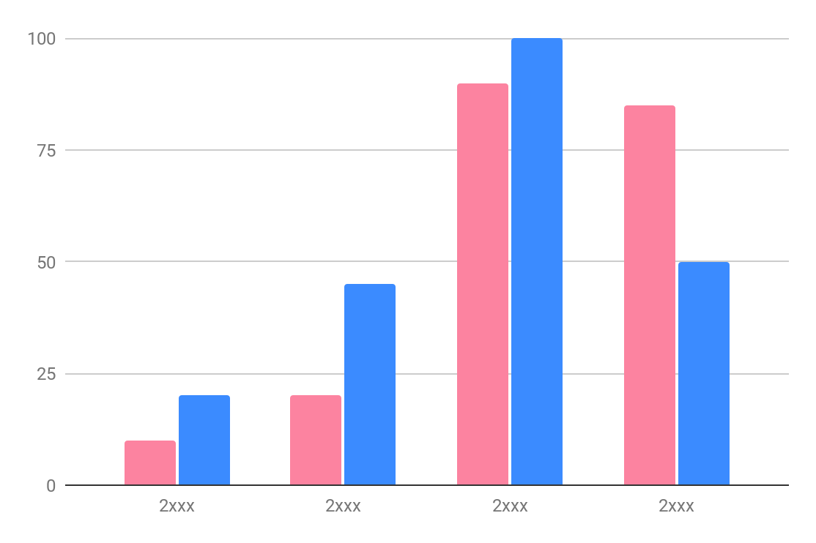
Tendency
20,000
Mars
Despite being red, Mars is a very cold planet
15,000
Mercury
Mercury is the closest planet to the Sun
Follow the link in the graph to modify its data and then paste the new one here. For more info, click here

Slide 35
Results
 | Outcome
Group | Test 1 | Test 2 | Test 3
A | 95/100 | 55/100 | 80/100
B | 80/100 | 25/100 | 66/100
C | 72/100 | 70/100 | 45/100
D | 60/100 | 60/100 | 86/100

Slide 36
Results analysis
Result A
Ceres
60%
Venus has extremely high temperatures
Mars
60%
Pluto
30%
Result B
Saturn
10%
Earth is the beautiful planet we all live
Result C
Neptune is the farthest planet from the Sun
Venus
Neptune
Jupiter

Slide 37
4,498,300,000
Big numbers catch your audience’s attention

Slide 38
Success rate
50,000
20,000
This is the number of total visitors we had last month
This is the number of patients and visitors we had last month

Slide 39
Conclusions
Mercury is the closest planet to the Sun and the smallest one in the Solar System—it’s only a bit larger than the Moon. The planet’s name has nothing to do with the liquid metal, since Mercury was named after a Roman god

Slide 40
Thanks!
Do you have any questions?
youremail@freepik.com
+34 654 321 432
yourwebsite.com
Please keep this slide for attribution

Slide 41
Alternative resources
Here’s an assortment of alternative resources whose style fits the one of this creative template:
VECTORS
Free vector flat-hand drawn coronavirus vaccine background

Slide 42
Resources
Did you like the resources in this template? Get them for free at our other websites:
PHOTOS
Free photo medium shot scientist working with microscope
Free photo close up researcher looking through ocular lens
VECTORS
Vaccine development landing page
Scientists holding dna molecules
Scientists holding dna molecules I
ICONS
Genetic icon pack lineal

